Slide 1
Attention mechanism
Alberto TONDA, Ph.D. (Senior permanent researcher, DR)
UMR 518 MIA-PS, INRAE, AgroParisTech, Université Paris-Saclay UAR 3611, Institut des Systèmes Complexes de Paris Île-de-France

Slide 2
Outline
What is Attention?
Explaining Attention
Attention head
Attention-based architectures

Slide 3
What is Attention?
When dealing with sequences
Elements away from current position might have strong impact!
E.g. “Don’t go insane, find the real identity of, and kill one by one all the reviewers that have just rejected your awesome paper.”
“Don’t” here is extremely important for meaning of sentence
Seq2seq architectures (even LSTMs) tend to lose memory
Start of sequence has low impact on long sequences
Old information tends to be lost with updates of hidden state

Slide 4
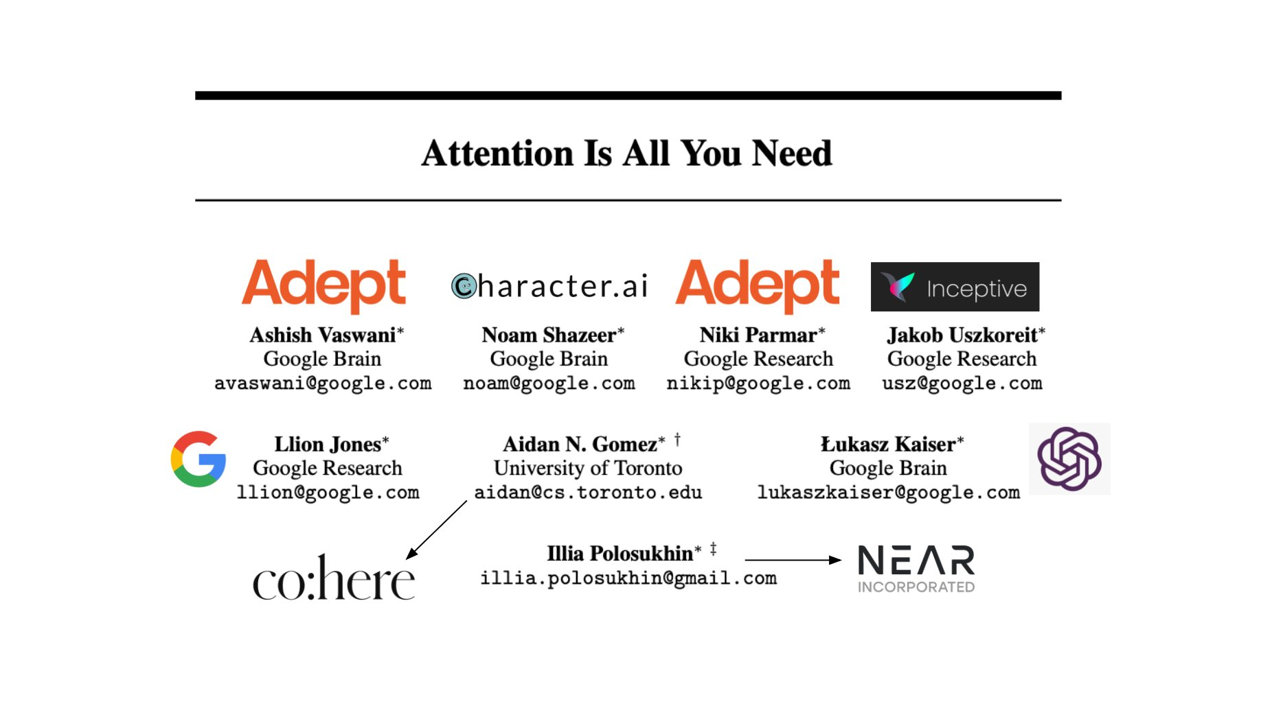
What is Attention?

Slide 5
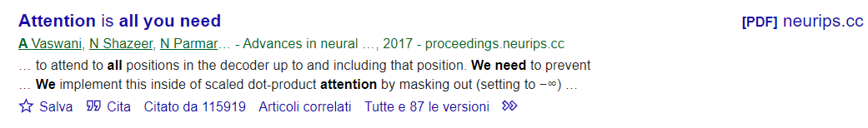
What is Attention?

Slide 6
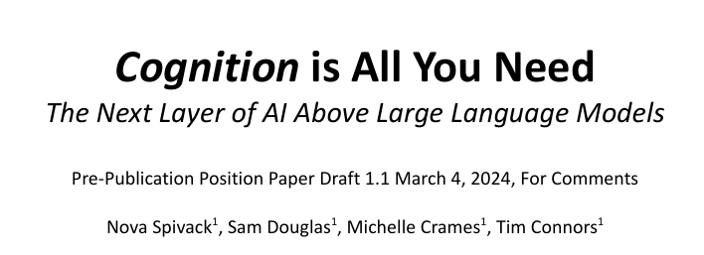
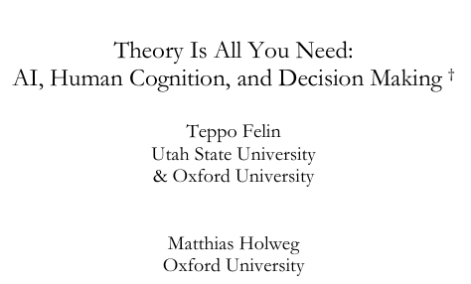
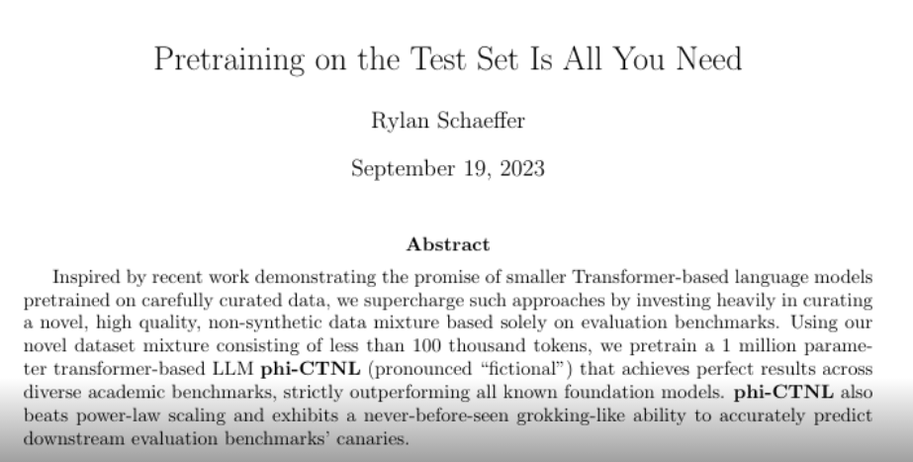

Emulation is the sincerest form of flattery

Slide 7
Obstacles in explaining Attention
Architecture of an Attention module has two aims
Follow a certain idea of what it should do (“what”)
Maximize computational speed (“how”)
The practical implementation can be hard to follow
Computations of Attention can be massively parallelized
“When it does not make sense, it makes speed”

Slide 8
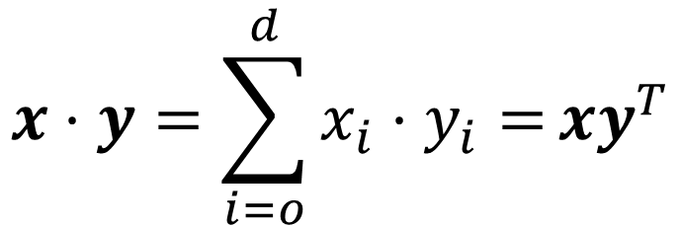
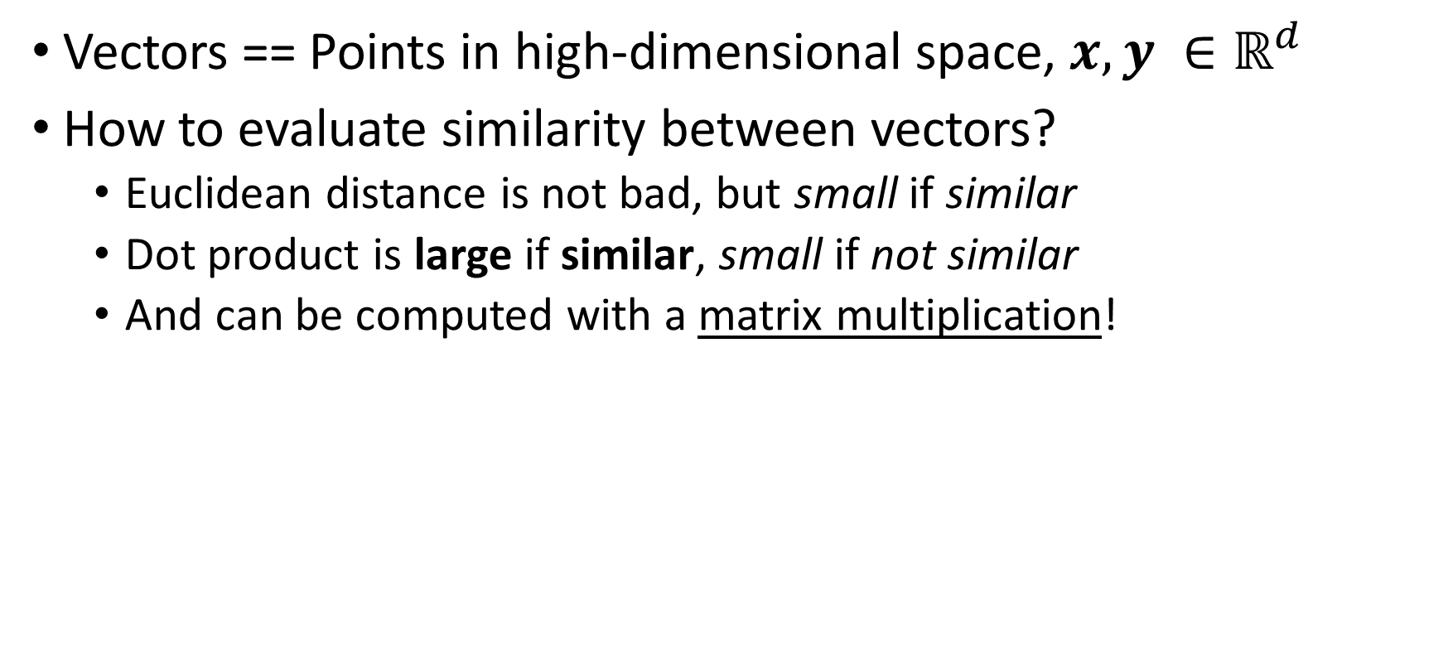
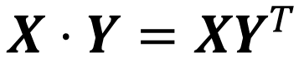
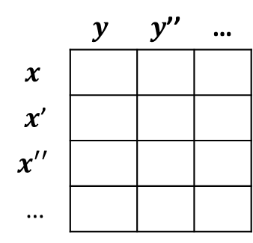
Similarity between vectors
Vectors == Points in high-dimensional space, $x, y ∈ℝ^{d}$
How to evaluate similarity between vectors?
Euclidean distance is not bad, but small if similar
Dot product is large if similar, small if not similar
And can be computed with a matrix multiplication!
 | $$y$$ | $y$’’ | …
$$x$$
$x$’
$$x′′$$
…
$$x⋅y=\sum_{i=o}^{d}{x_{i}⋅y_{i}=}xy^{T}$$
$$X⋅Y=XY^{T}$$

Slide 9
Similarity between vectors
assassinate
kill
spare

Slide 10
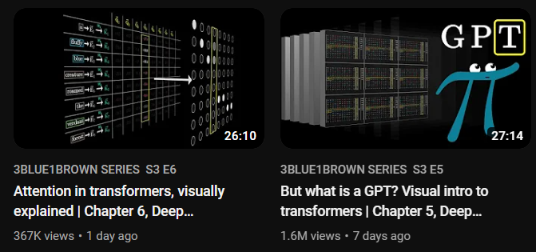

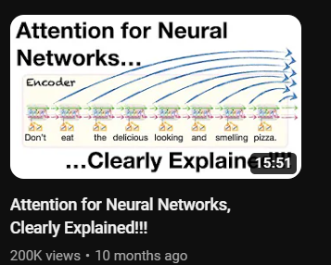
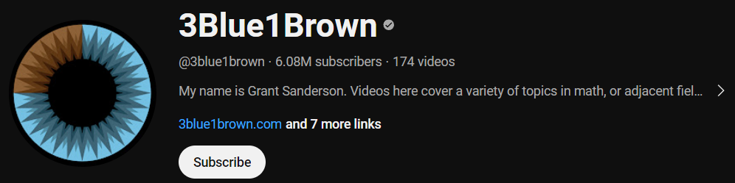
Attention, explained better than here

Slide 11

Attention, explained better than here

Slide 12
Attention
Attention is specifically designed to work on vocabularies
More specifically, embeddings of vocabularies
It can only work between two finite sets of discrete elements
Very often, the two sets are the same (self-attention)
But sometimes, different sets (cross-attention)
Encoding the way in which the presence of nearby tokens modifies the meaning (embedding) of a target token, for all tokens in the context window

Slide 13
Attention
Attention is specifically designed to work on vocabularies
More specifically, embeddings of vocabularies
It can only work between two finite sets of discrete elements
Very often, the two sets are the same (self-attention)
But sometimes, different sets (cross-attention)
Encoding the way in which the presence of nearby tokens modifies the meaning (embedding) of a target token, for all tokens in the context window
Meaning is encoded as a position in the embedding vector space; so, in practice, Attention computes a displacement in the embedding vector space that reflects the shift in meaning of the token, given the context.

Slide 14
Attention
“Don’t go insane, find the real identity of, and kill one by one all the reviewers that have just rejected your awesome paper.”
kill

Slide 15
Attention
“Don’t go insane, find the real identity of, and kill one by one all the reviewers that have just rejected your awesome paper.”
kill

Slide 16
Attention
“Don’t go insane, find the real identity of, and kill one by one all the reviewers that have just rejected your awesome paper.”
kill
kill
one

Slide 17
Attention
“Don’t go insane, find the real identity of, and kill one by one all the reviewers that have just rejected your awesome paper.”
kill
assassinate
kill
one
kill
everybody
massacre

Slide 18
Attention
“Don’t go insane, find the real identity of, and kill one by one all the reviewers that have just rejected your awesome paper.”
paper
kill
kill
kill
one

Slide 19
Attention
“Don’t go insane, find the real identity of, and kill one by one all the reviewers that have just rejected your awesome paper.”
paper
kill
kill
kill
one
don’t
kill
spare

Slide 20
Attention
“Don’t go insane, find the real identity of, and kill one by one all the reviewers that have just rejected your awesome paper.”
paper
kill
kill
kill
one
Attention module answers questions:
Which other tokens should modify target?
By how much?
don’t
kill

Slide 21
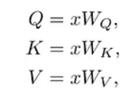
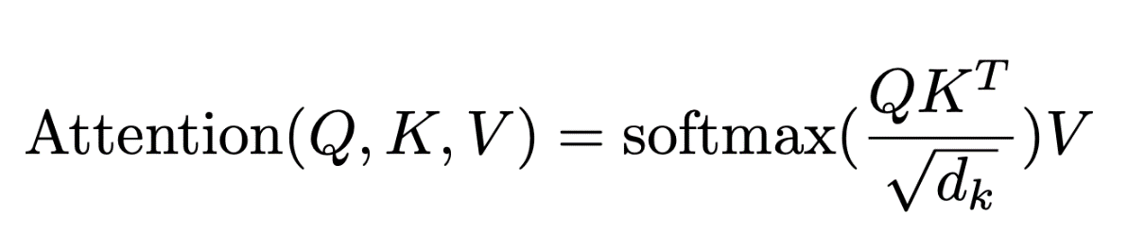
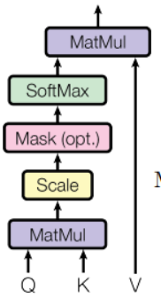
Attention head at a glance
Displacement

Slide 22
Attention head at a glance
Displacement
Q: Queries
K: Keys
V: Values

Slide 23
Attention head at a glance
Displacement
Q: who is influencing me?
Q: Queries
K: Keys
V: Values
K: we are influencing you!
V: ok, but by how much?

Slide 24
Attention head at a glance
Displacement
Which other tokens should modify target?

Slide 25
Attention head at a glance
Displacement
2. By how much?

Slide 26
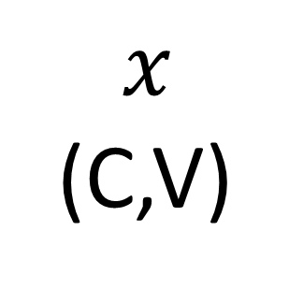
Attention head
Attention module
Embedding
$$x$$
(C,V)
TENSOR
SOS
T₁
T₂
T_{N}
EOS
NA
Size of the vocabulary
(one-hot encoding), V
…
…
NA
Size of the context window, C

Slide 27
Attention head
Embedding
(V,E)
1
1
0
0
0
0
0
0
0
0
…
1
0
0
…
…
…
1
…
…
…
$$x$$
(C,V)
Size of the vocabulary
(one-hot encoding), V
TENSOR
0
0
1
…
0
0
0
…
…
…
…
…
…
…
0
0
0
…
0
0
0
…
0
Size of the context window, C

Slide 28
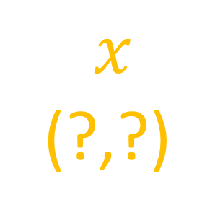
Attention head
$$x$$
(?,?)
Size ?
TENSOR
Size of the context window
Embedding
(V,E)

Slide 29
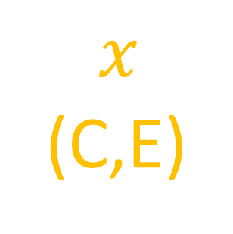
Attention head
-1.10
0.01
0.41
0.68
0.00
0.0
0.0
0.25
-1.03
-0.12
…
1.40
0.0
0.0
…
…
…
-1.01
…
…
…
$$x$$
(C,E)
Size of the embedding
(real values), E
TENSOR
0.80
-0.22
0.82
…
-0.28
0.0
0.0
…
…
…
…
…
…
…
-0.04
0.31
-0.19
…
0.99
-0.77
0.0
…
0.0
Size of the context window, C
Embedding
(V,E)

Slide 30
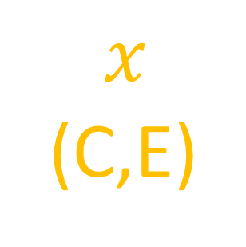
Attention head
$$x$$
(C,E)
Attention module
TENSOR
0.0
0.0
$$x$$
(C,E)
-1.10
0.01
0.41
0.68
0.00
0
0
TENSOR
See you later, brotha! I will wait for you after the Attention module
0.0
0.0
0.25
-1.03
-0.12
…
1.40
0
0
…
…
…
…
…
-1.01
…
…
…
Size of the embedding
(real values), E
0.0
0.0
0.80
-0.22
0.82
…
-0.28
0
0
…
…
…
…
…
…
…
…
…
Ok! See you later! I will have the same shape, but I doubt you will recognize me!
0.99
-0.77
0.0
0.0
-0.04
0.31
-0.19
…
0
…
0
Size of the context window, C

Slide 31


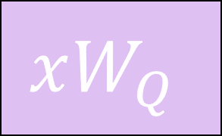
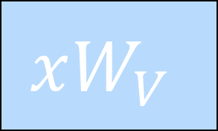

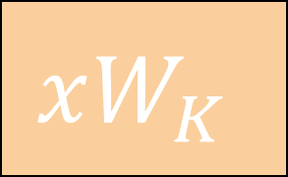
Attention head
$$Q$$
$$K$$
$$V$$
$$xW_{Q}$$
$$xW_{K}$$
$$xW_{V}$$
TENSOR
TENSOR
TENSOR

Slide 32
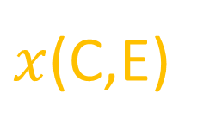
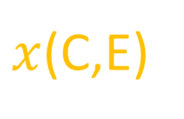
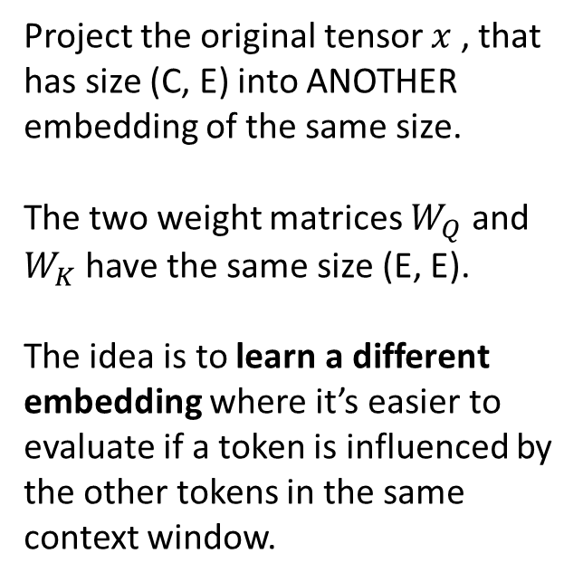
Attention head
Project the original tensor $x$ , that has size (C, E) into ANOTHER embedding of the same size.
The two weight matrices $W_{Q}$ and $W_{K}$ have the same size (E, E).
The idea is to learn a different embedding where it’s easier to evaluate if a token is influenced by the other tokens in the same context window.
$$Q$$
$$K$$
$$xW_{Q}$$
$$xW_{K}$$
(E, E)
(E, E)
TENSOR
TENSOR
$x$(C,E)
$x$(C,E)

Slide 33

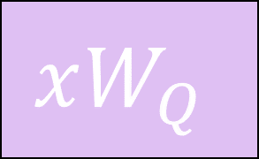


Attention head
The two resulting tensors have size (C, E).
Why two different projections in same-sized space? Because a token could be influenced by a lot of other tokens (strong query), while influence the others very little (weak key). They could influence and be influenced differently.
If Q and K used the same projection, the meaning would be that a token would influence and be influenced by the same other tokens. But a name is strongly influenced by adjectives, and not vice-versa.
TENSOR
TENSOR
(C, E)
(C, E)
$$Q$$
$$K$$
$$xW_{Q}$$
$$xW_{K}$$

Slide 34
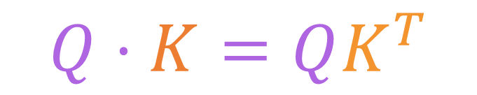
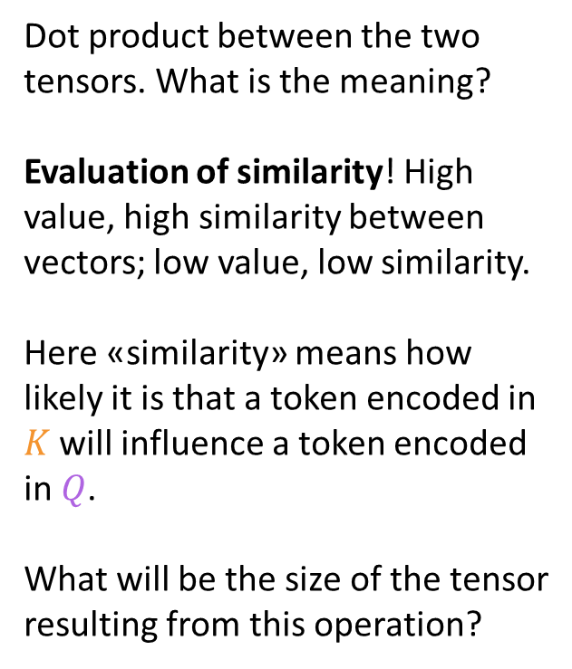
Attention head
Dot product between the two tensors. What is the meaning?
Evaluation of similarity! High value, high similarity between vectors; low value, low similarity.
Here «similarity» means how likely it is that a token encoded in $K$ will influence a token encoded in $Q$.
What will be the size of the tensor resulting from this operation?
(C, E)
(C, E)
(C, E)
(E, C)
$$Q⋅K=QK^{T}$$
TENSOR
TENSOR
(C, E)
$$Q$$
$$K$$
$$xW_{Q}$$
$$xW_{K}$$

Slide 35
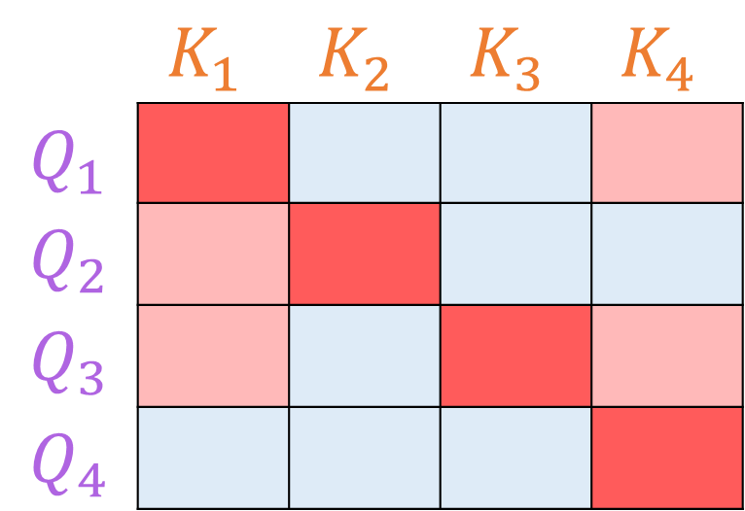

Meaning of the $QK^{T}$ matrix
 | $$K_{1}$$ | $$K_{2}$$ | $$K_{3}$$ | $$K_{4}$$
$Q_{1}$
$$Q_{2}$$
$$Q_{3}$$
$$Q_{4}$$

Slide 36
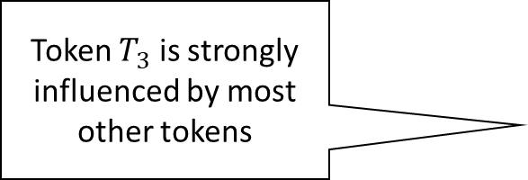
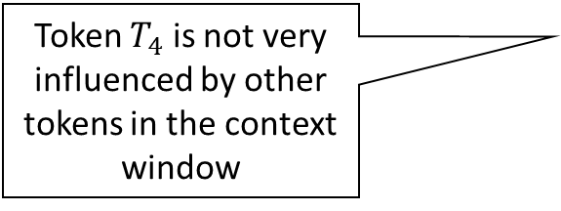
Meaning of the $QK^{T}$ matrix
 | $$K_{1}$$ | $$K_{2}$$ | $$K_{3}$$ | $$K_{4}$$
$Q_{1}$
$$Q_{2}$$
$$Q_{3}$$
$$Q_{4}$$
Token $T_{3}$ is strongly influenced by most other tokens
Token $T_{4}$ is not very influenced by other tokens in the context window

Slide 37
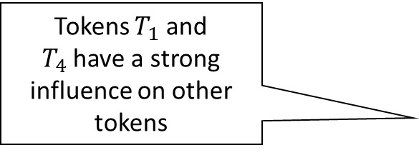
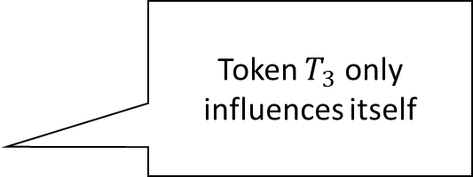
Meaning of the $QK^{T}$ matrix
Tokens $T_{1}$ and $T_{4}$have a strong influence on other tokens
Token $T_{3}$ only influences itself
 | $$K_{1}$$ | $$K_{2}$$ | $$K_{3}$$ | $$K_{4}$$
$Q_{1}$
$$Q_{2}$$
$$Q_{3}$$
$$Q_{4}$$

Slide 38
Meaning of the $QK^{T}$ matrix
 | $$K_{1}$$ | $$K_{2}$$ | $$K_{3}$$ | $$K_{4}$$
$Q_{1}$
$$Q_{2}$$
$$Q_{3}$$
$$Q_{4}$$
Why does the diagonal have the highest values?

Slide 39
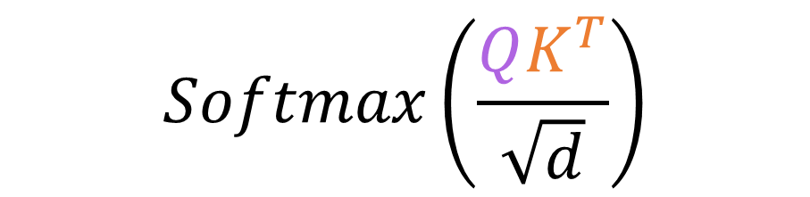
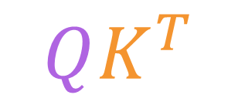
Attention head
(C, C)
The result has size (C, C). The meaning is how strongly each token in the context window has influence on each other token.
Now, the numbers here can be all over the place, so there is a normalization and a Softmax to have nice values in (0,1) that also add up to 1, for each column of the resulting matrix.
TENSOR
$$Softmax\left(\frac{QK^{T}}{\sqrt{d}}\right)$$
(C, C)
TENSOR
$$QK^{T}$$

Slide 40

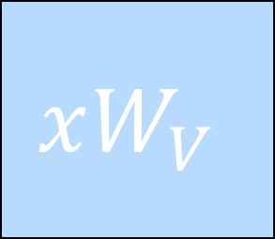
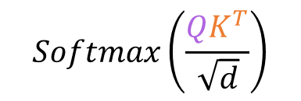
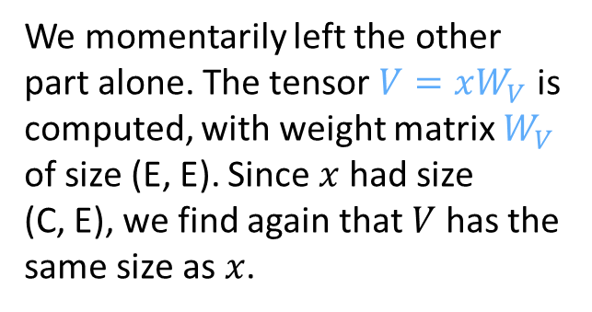
Attention head
We momentarily left the other part alone. The tensor $V=xW_{V}$ is computed, with weight matrix $W_{V}$ of size (E, E). Since $x$ had size (C, E), we find again that $V$ has the same size as $x$.
TENSOR
$$V$$
TENSOR
(C, C)
(C, E)
$$xW_{V}$$
(E, E)
$$Softmax\left(\frac{QK^{T}}{\sqrt{d}}\right)$$

Slide 41
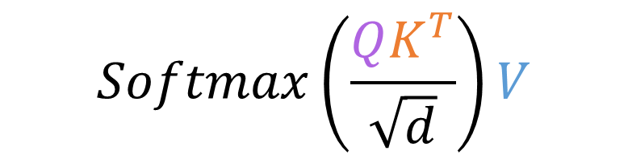
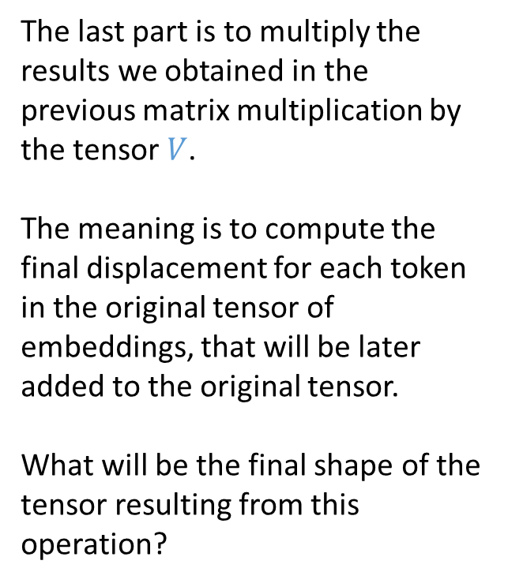
Attention head
$$Softmax\left(\frac{QK^{T}}{\sqrt{d}}\right)V$$
The last part is to multiply the results we obtained in the previous matrix multiplication by the tensor $V$.
The meaning is to compute the final displacement for each token in the original tensor of embeddings, that will be later added to the original tensor.
What will be the final shape of the tensor resulting from this operation?
TENSOR
$$V$$
TENSOR
(C, C)
(C, E)
$$xW_{V}$$
$$Softmax\left(\frac{QK^{T}}{\sqrt{d}}\right)$$

Slide 42
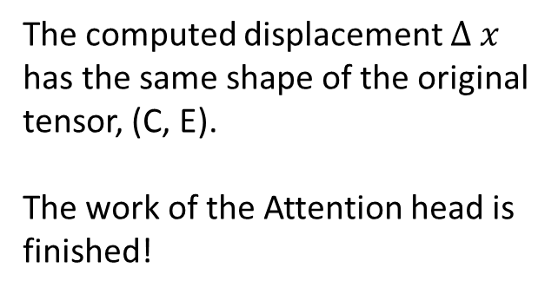

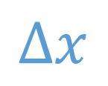

Attention head
The computed displacement $Δ x$ has the same shape of the original tensor, (C, E).
The work of the Attention head is finished!
TENSOR
$$Δx$$
(C, E)
$$Softmax\left(\frac{QK^{T}}{\sqrt{d}}\right)V$$
TENSOR
TENSOR
$$Softmax\left(\frac{QK^{T}}{\sqrt{d}}\right)$$
$$V$$

Slide 43

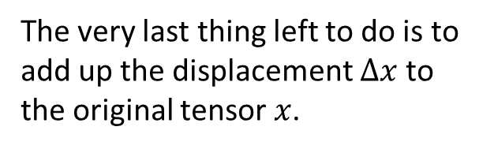
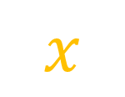
Attention head
The very last thing left to do is to add up the displacement $Δx$ to the original tensor $x$.
TENSOR
Oh my god, brotha! Is that you? You changed a lot while we were apart!
I told you, I would be a changed tensor. I went through A LOT. But now we are back together, brother! And we will be unstoppable!
TENSOR
TENSOR
$$x$$
(C,E)
$$Δx$$
(C, E)

Slide 44
Attention head
The very last thing left to do is to add up the displacement $Δx$ to the original tensor $x$.
TENSOR
Oh, you went through a lot? Did you know that real-world architectures that use transformers have 96 attention heads in parallel?
TENSOR
TENSOR
…
$$x$$
(C,E)
$$Δx$$
(C, E)

Slide 45
Attention head
The very last thing left to do is to add up the displacement $Δx$ to the original tensor $x$.
TENSOR
Yeah, then they aggregate the displacements with linear modules. Oh, and they have like 96 stacked Attention modules, one after the other, and…
…brother, I swear to Euclid, shut up or I will transpose and then dot product you into oblivion!
TENSOR
TENSOR
$$x$$
(C,E)
$$Δx$$
(C, E)

Slide 46
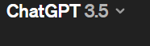
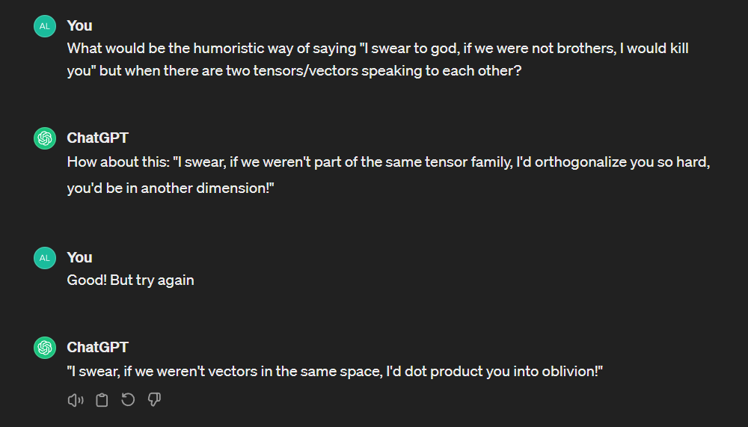
It works!
This type of architecture makes it possible to embed complex semantic meaning in vectors

Slide 47
But the implementation…?
The implementation is using multi-head attention

Slide 48
Attention to positions…?
How does an Attention head take into account relative position of tokens in the sequence?

Slide 49
Attention to position
It does not. The result of Attention is permutation invariant
However, for sequences, order is important!
Several ways of solving the issue

Slide 50
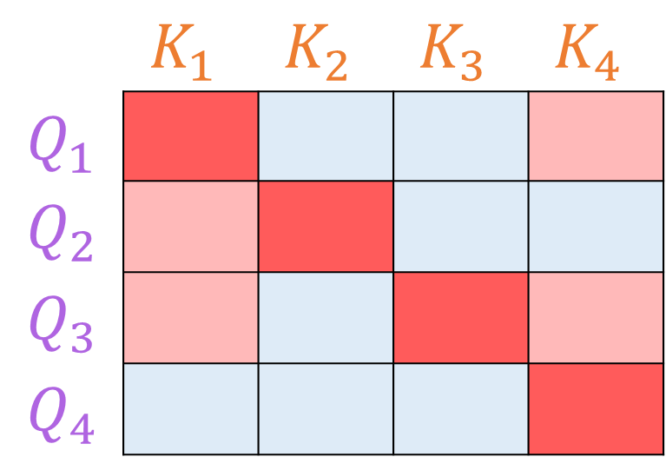
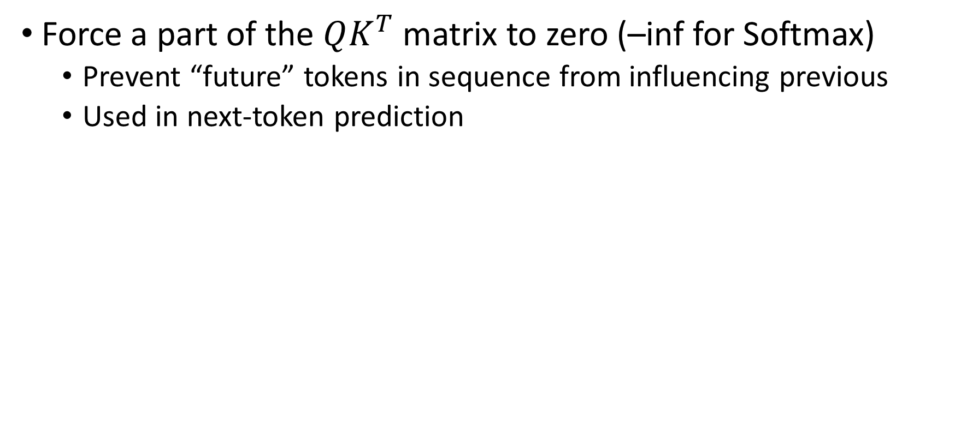

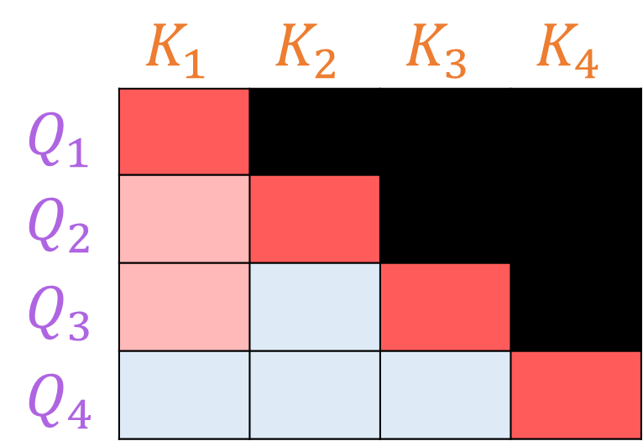
Masking
Force a part of the $QK^{T}$ matrix to zero (–inf for Softmax)
Prevent “future” tokens in sequence from influencing previous
Used in next-token prediction
 | $$K_{1}$$ | $$K_{2}$$ | $$K_{3}$$ | $$K_{4}$$
$Q_{1}$
$$Q_{2}$$
$$Q_{3}$$
$$Q_{4}$$
 | $$K_{1}$$ | $$K_{2}$$ | $$K_{3}$$ | $$K_{4}$$
$Q_{1}$
$$Q_{2}$$
$$Q_{3}$$
$$Q_{4}$$
$$−∞ \\ e^{−∞}=0$$
Masking

Slide 51
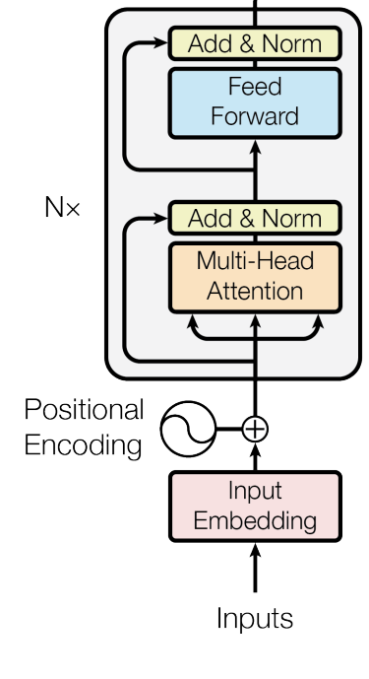
Positional encoding
Encode the relative position of the token in its embedding
Small displacement added to the embedding of each token
Displacement is the same per same relative position in window

Slide 52

Outputs of a Transformer architecture

Slide 53


Questions?
Bibliography - Vaswani, A. et al. (2017). Attention is all you need. Advances in Neural Information Processing Systems. - Starmer, J. (2023). Attention for Neural Networks, Clearly Explained!!!, https://www.youtube.com/watch?v=PSs6nxngL6k - 3blue1brown (2024). Transformers (how LLMs work) explained visually | DL5, https://www.youtube.com/watch?v=wjZofJX0v4M - 3blue1brown (2024). Attention in transformers, visually explained | DL6, https://www.youtube.com/watch?v=eMlx5fFNoYc
Images and videos: unless otherwise stated, I stole them from the Internet. I hope they are not copyrighted, or that their use falls under the Fair Use clause, and if not, I am sorry. Please don’t sue me.

